Slide 1

Rice crop analysis
Presented by:
Shinanmuhammed c

Slide 2
INDRODUCTION
In this presentation we will explore through ‘climate change impact on agriculture’.
Our aim is two find the Country with largest cropyeild and increase India’s cropyield by comparing with that country

Slide 3
Description
Year: The year when the data was recorded.
Country: The name of the country where the data was collected.
Region: The geographical region where the country is located.
Crop_Type: The type of crop being cultivated.
Average_Temperature_C: The average temperature in degrees Celsius during the year.
Total_Precipitation_mm: The total amount of precipitation (rainfall) in millimeters over the year.
CO2_Emissions_MT: The amount of carbon dioxide (CO2) emissions in metric tons.
Crop_Yield_MT_per_HA: The crop yield in metric tons per hectare (MT/HA).
Extreme_Weather_Events: The number of extreme weather events recorded during the year.
Irrigation_Access_%: The percentage of land with access to irrigation systems.
Pesticide_Use_KG_per_HA: The amount of pesticide used in kilograms per hectare.
Fertilizer_Use_KG_per_HA: The amount of fertilizer used in kilograms per hectare.
Soil_Health_Index: A composite score reflecting the overall health and quality of the soil.
Adaptation_Strategies: Strategies adopted by the region or country to adapt to changing environmental conditions.
Economic_Impact_Million_USD: The economic impact of environmental factors measured in millions of US dollars.

Slide 4
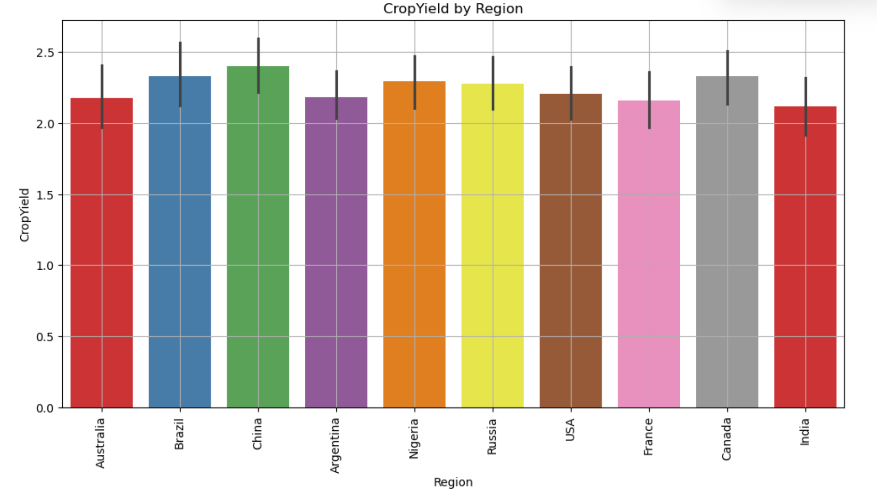
This plot shows cropyield of rice over different Countries.
From this we can see china having a high cropyield compared to others

Slide 5
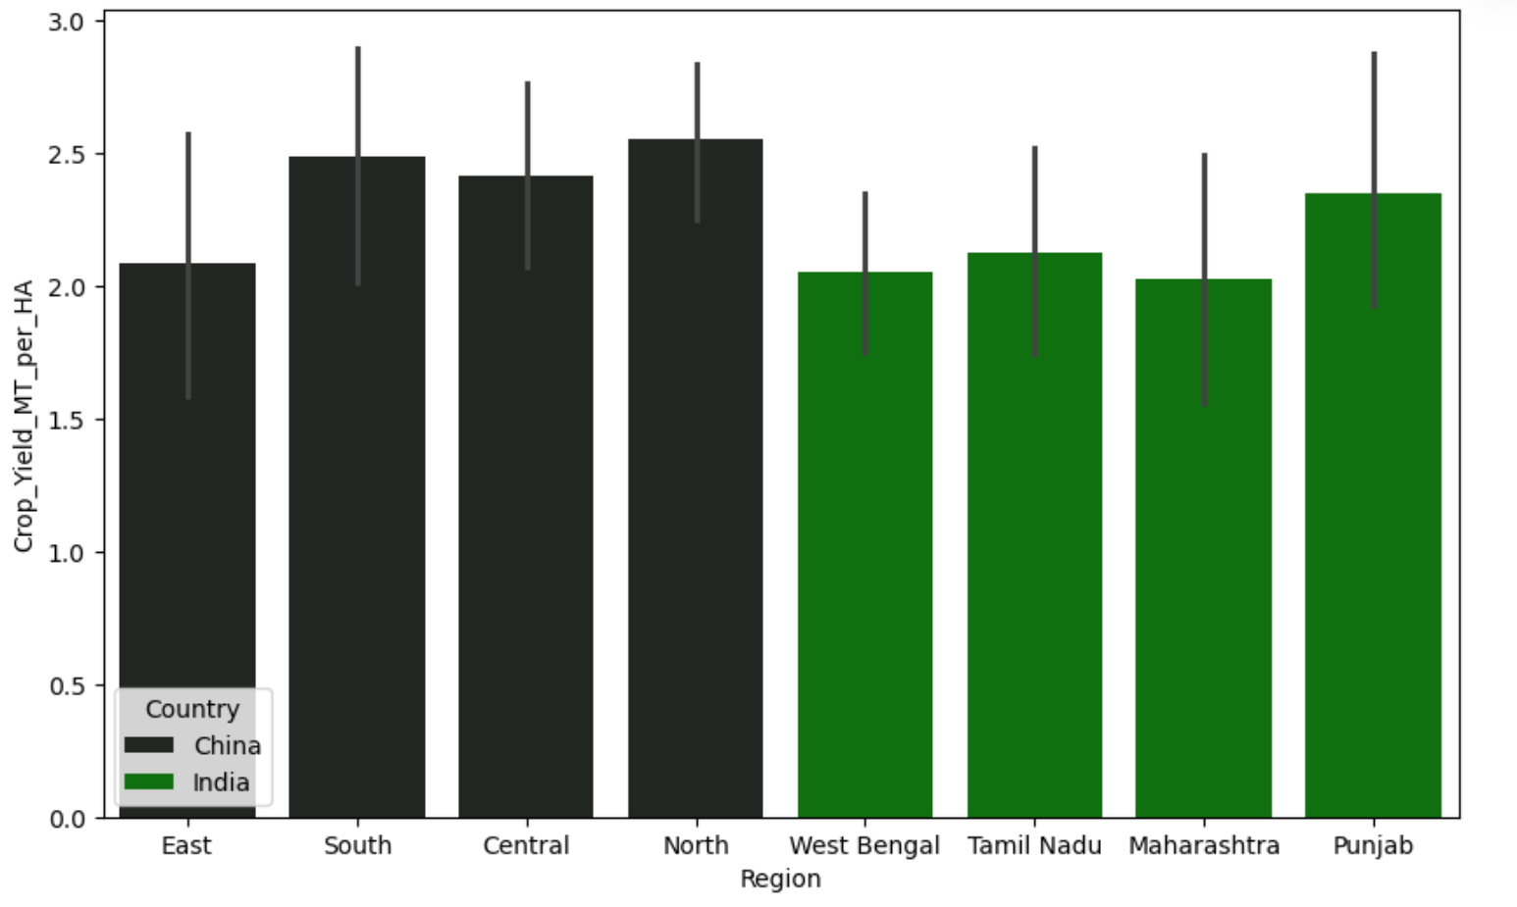
In this plot Regions of India and China are compared on the basis of cropyield.

Slide 6
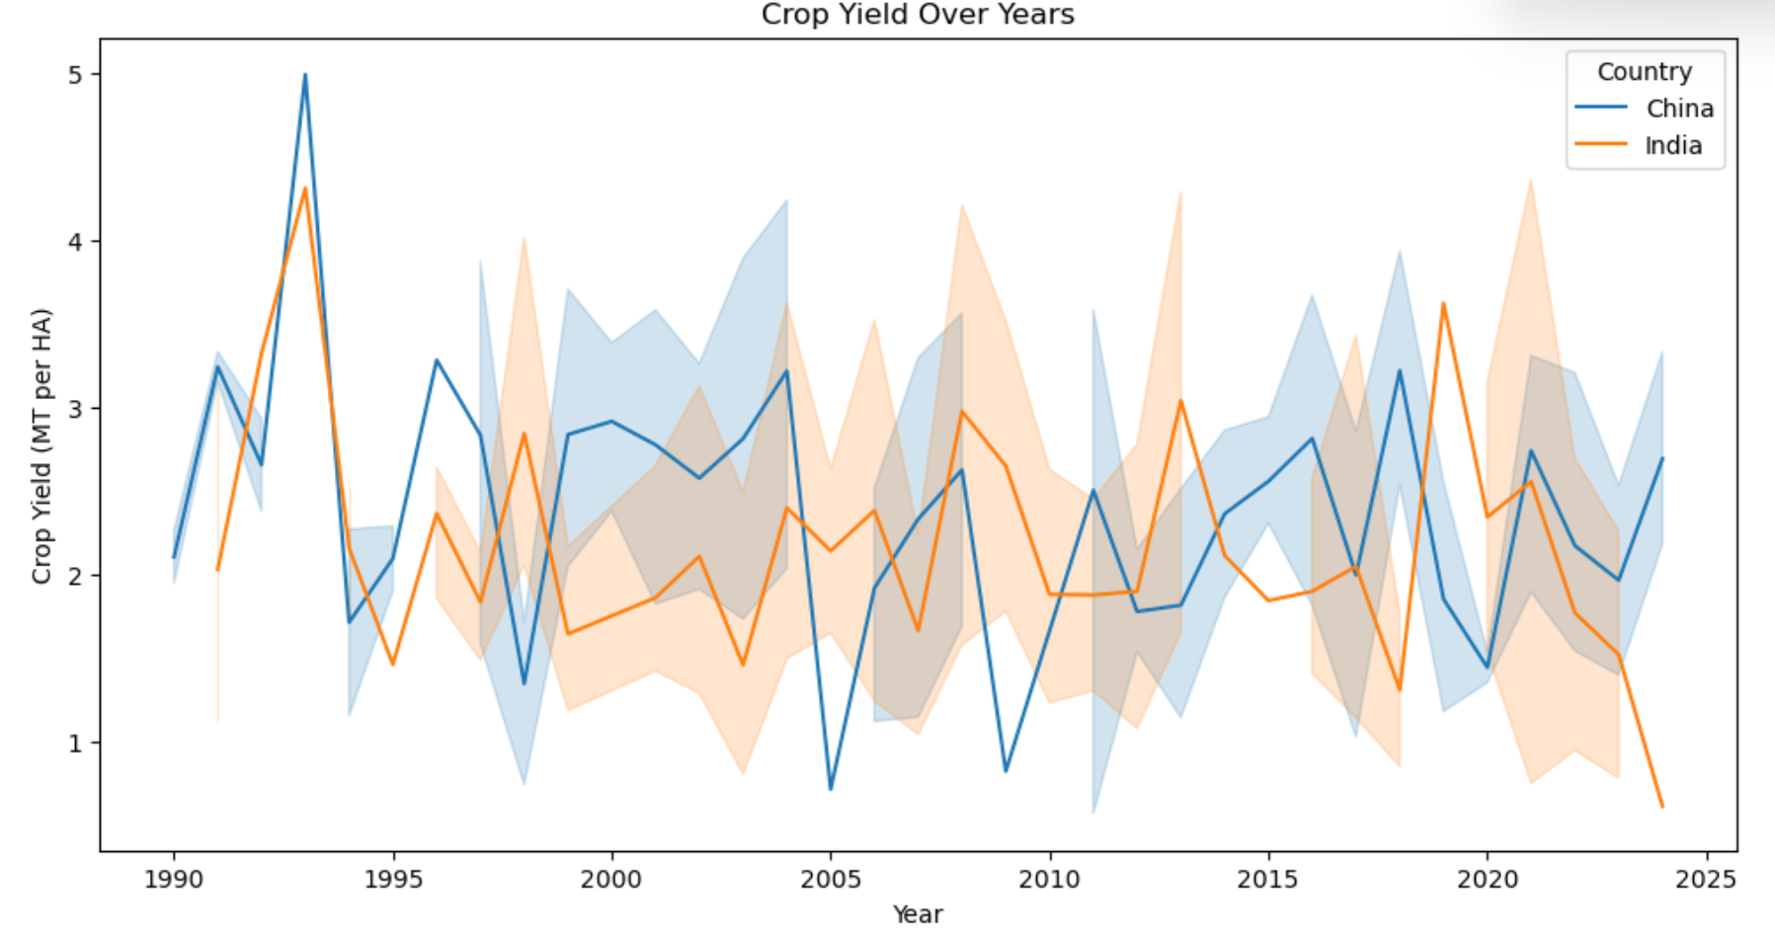
In this we can understand the cropyield of India and China over years from 1990 to 2025.

Slide 7
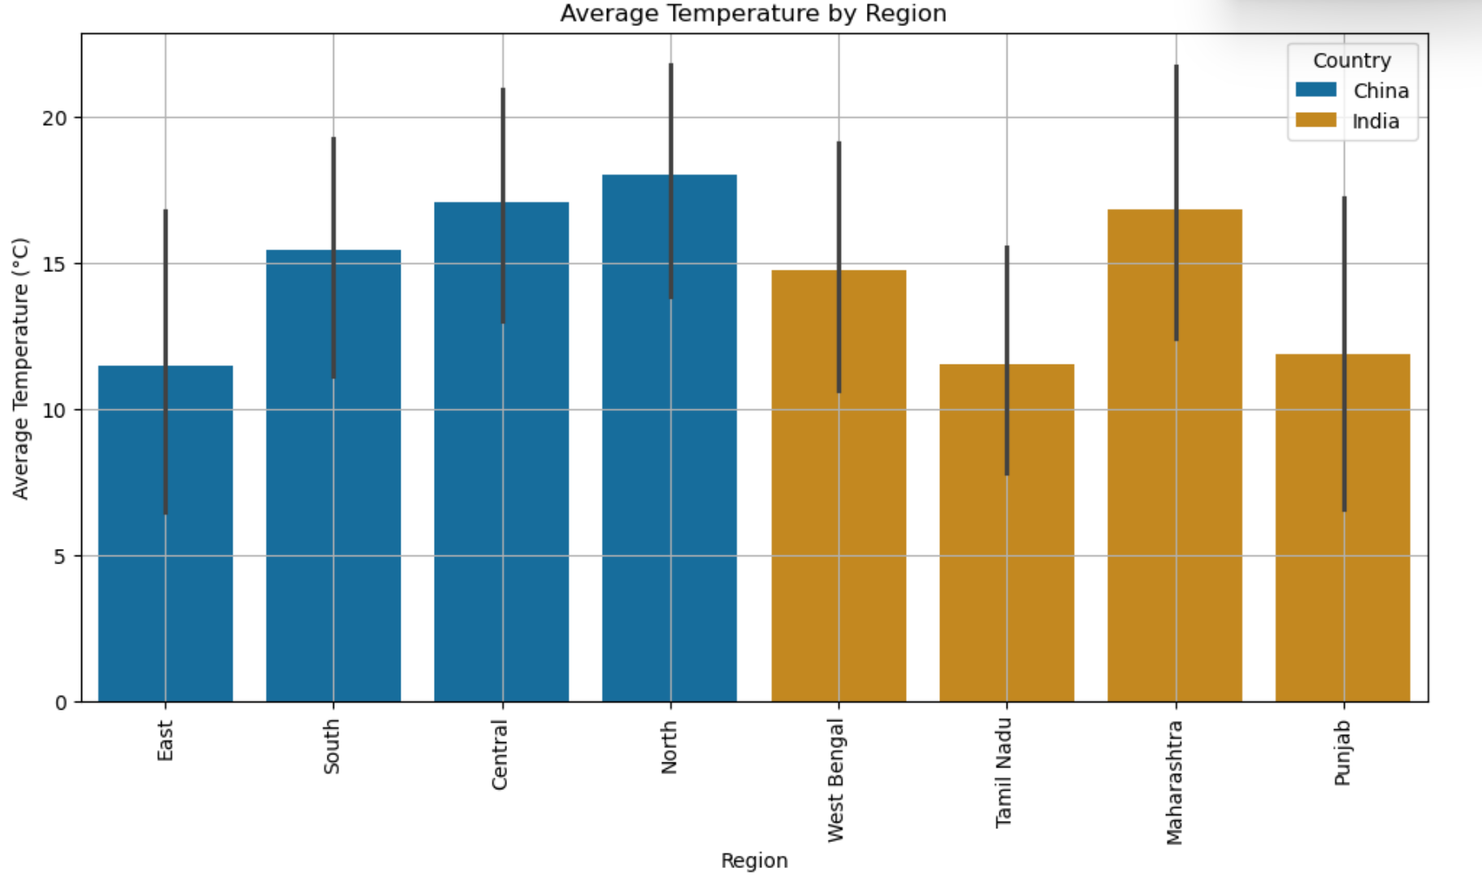
From this plot we gets average temperature over regions.

Slide 8
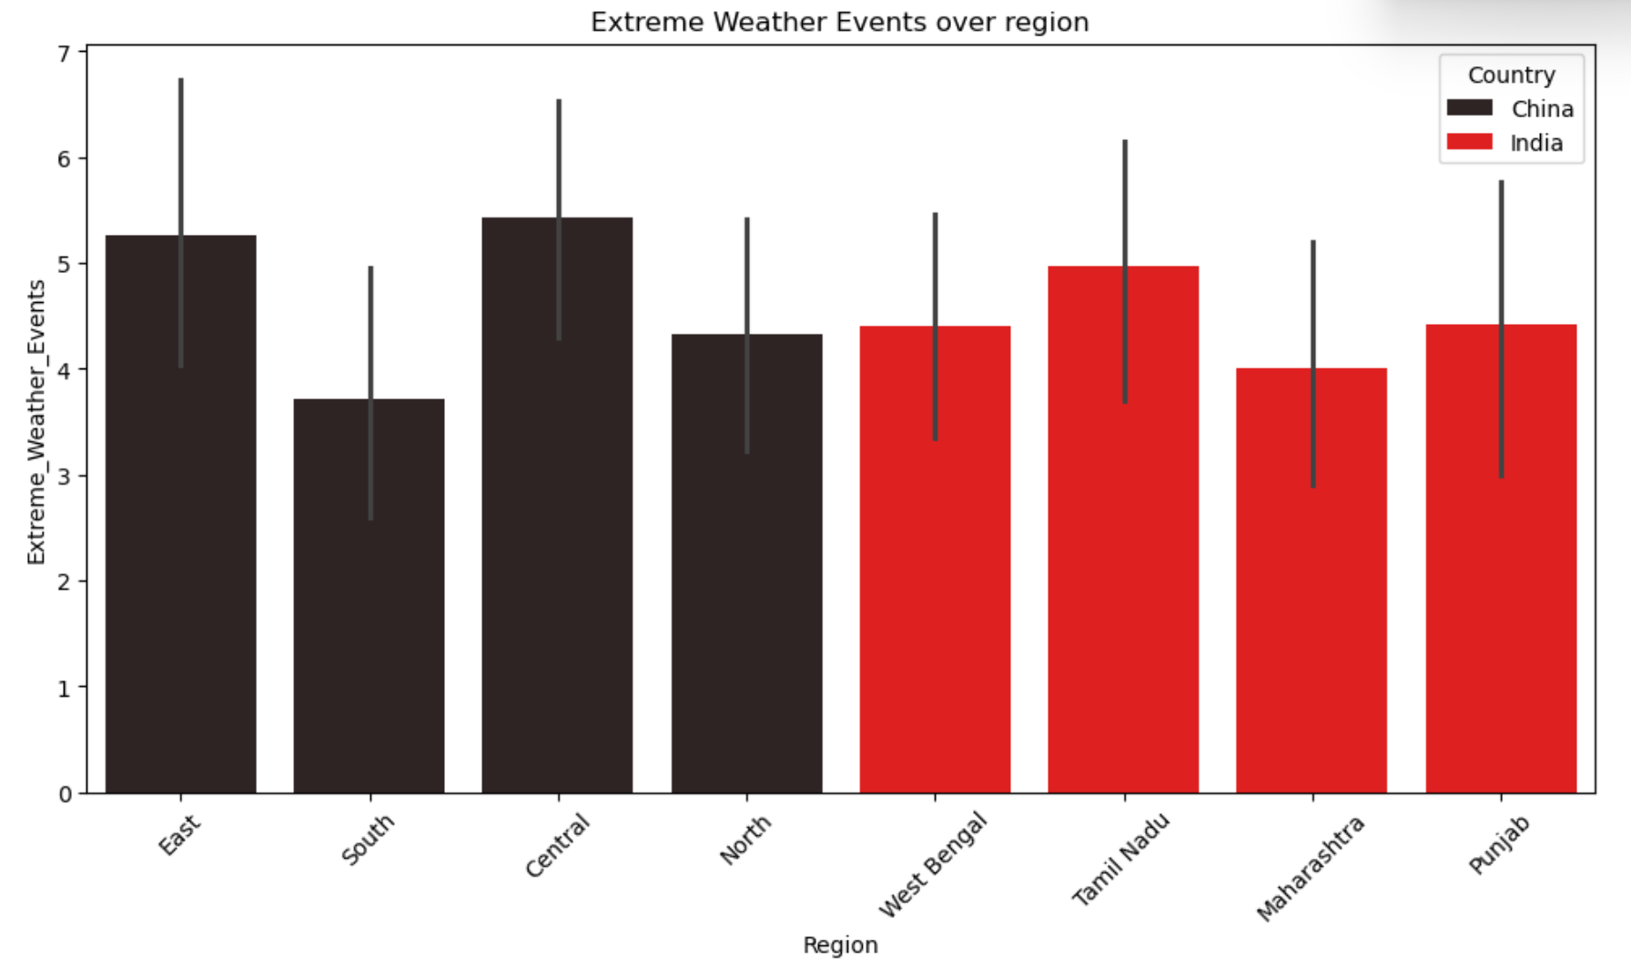
From this Plot we can see the weather events over regions of India and China.

Slide 9
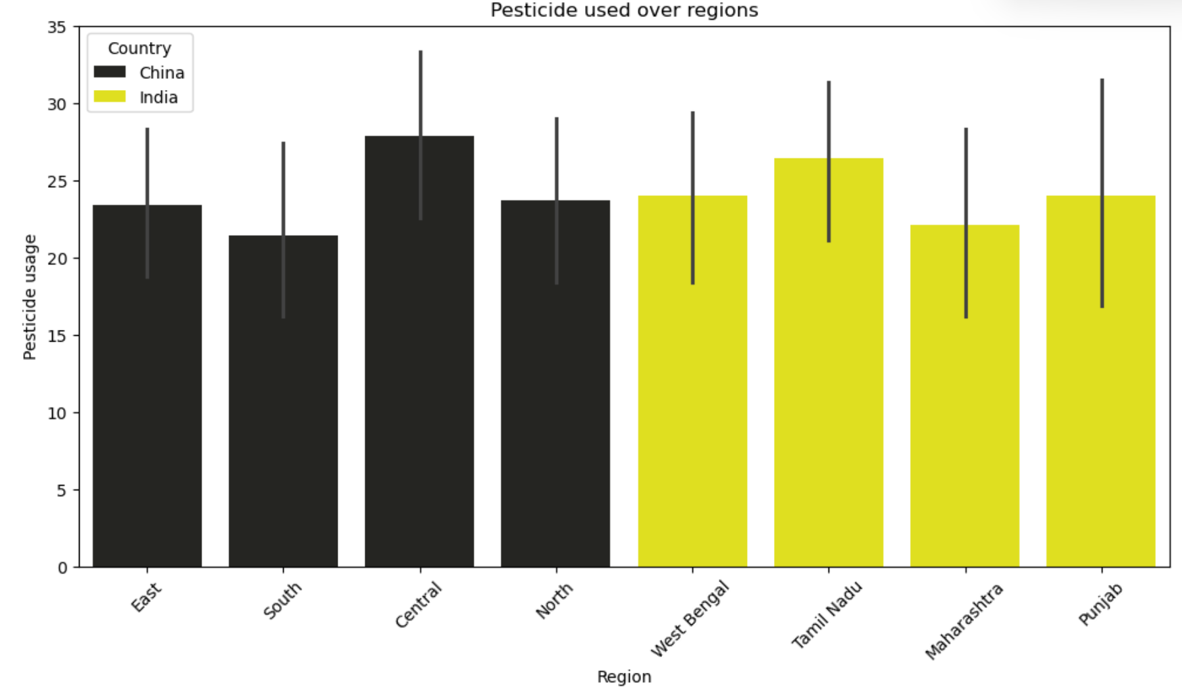
From this we can see the pesticide use over India and China.

Slide 10
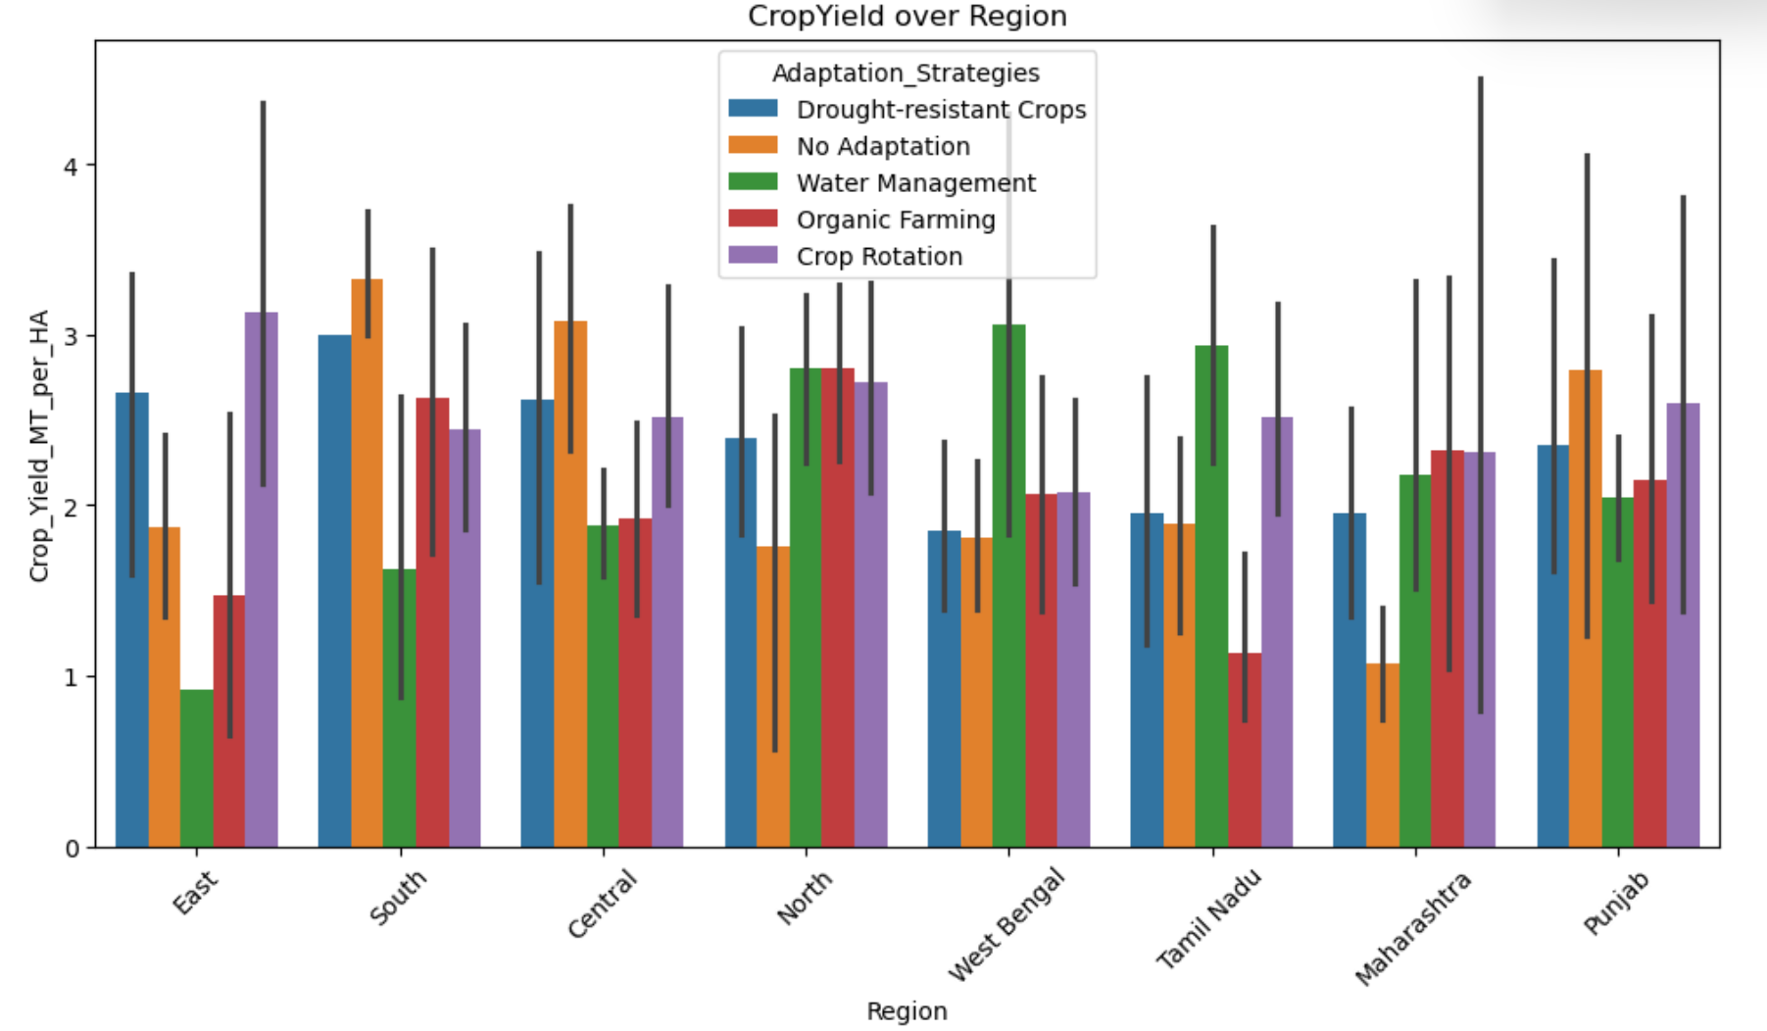
From this we can understand the cropyield over India and China with their adaptation strategies.

Slide 11
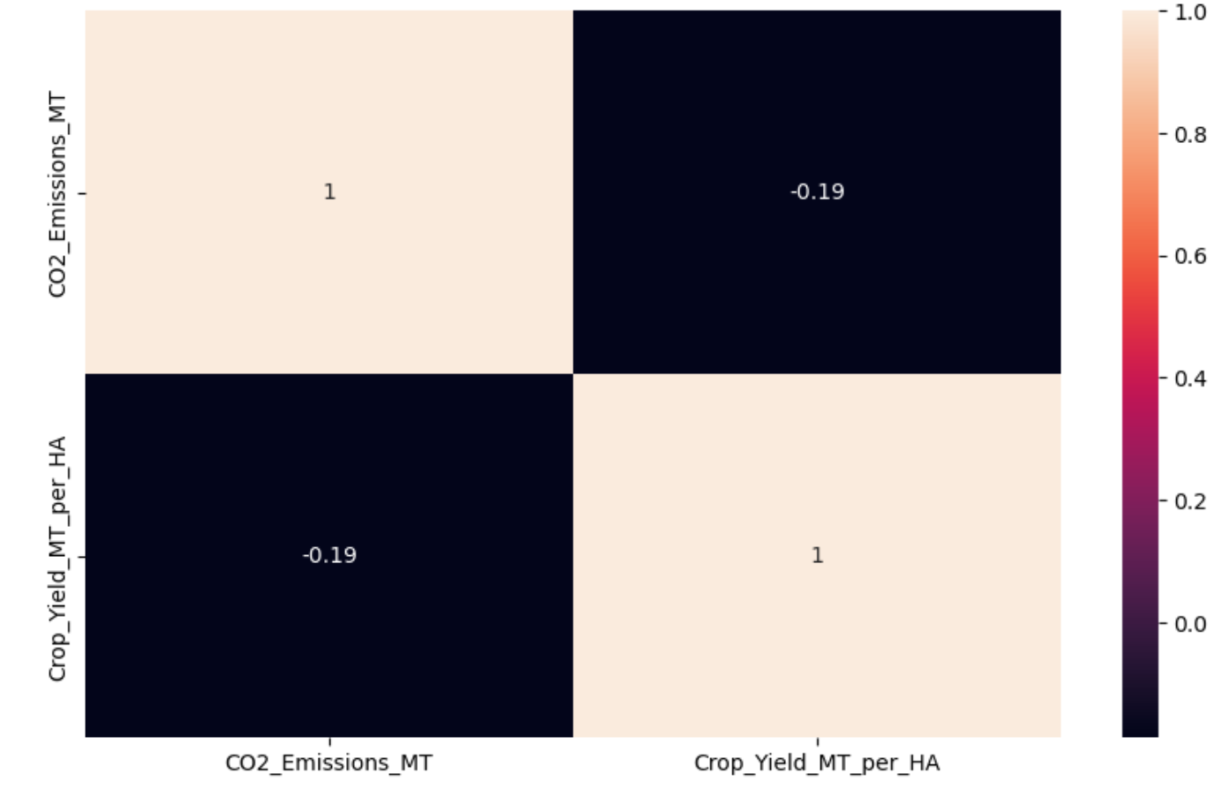
From this heatmap it is clear that when CO2 emission is inversely proportion to cropyiels.

Slide 12
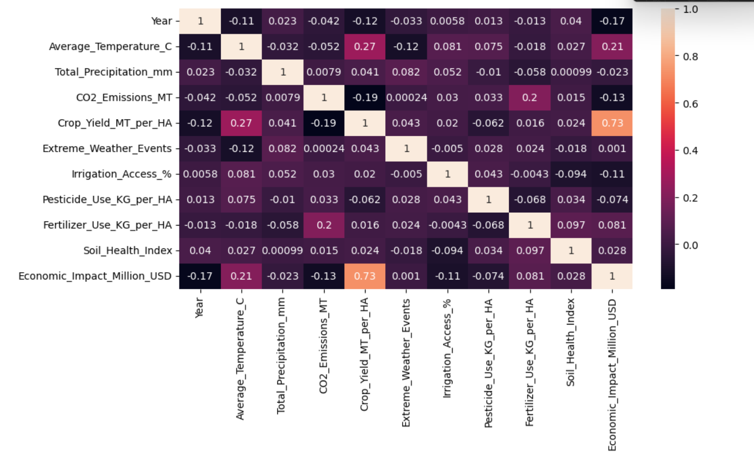
CORRILATION OF DATA

Slide 13
SUGGESTION FOR INCREASING RICE CROPYIELD IN INDIA
We can increase the cropyield of India by using good pesticides in accurate from.
Weather also plays a major role in cropyeild. There should be proper solution to overcome this situation.
India should have proper strategies according to the crop type and soil type.
Temperature should be controlled according to willing of the croptype.

Slide 14
Thank you

